Slide 1

Minor Project Presentation on Python based GUI for computer vision and image processing application
Submitted by:
Nihar Kashyap (CSM20005)
MCA 3rd Sem
Tezpur University

Slide 2
CONTENTS
Introduction.
Objectives.
What is Image Processing
Imag Pre Processing
Image Segmentation
Implementation and results
Conclusion
Thank You

Slide 3
INTRODUCTION
Image processing can be defined as a method to perform some operations on an image
Various libraries in languages like python and C++ are available for image processing applications
those libraries are complex and beyond the understanding of the common man
It is also time consuming as we have to install the libraries and setup the required environment
There are not many applications that can help users carry out real time image processing tasks
We aim to reduce this gap by developing a web based Image Processing applications that will be publicly available for everyone to carry out image processing tasks

Slide 4
OBJECTIVES
To create a web application for carrying out image processing tasks right from the browser.
Carry out image processing tasks without the hassle of installing additional tools and libraries
To make it easier to use for users who are expert as well as novice to the image processing field.
Make all image processign functions available under one hood

Slide 5
What is Image Processing
Image processing is a method to perform some operations on an image, in order to get an enhanced image or to extract some useful information from it
It is a type of signal processing in which input is an image and output may be image or characteristics/features associated with that image
Importance and necessity of digital image processing stems from two principal application areas: the first being the Improvement of pictorial information for human interpretation and the second being the Processing of a scene data for an autonomous machine perception

Slide 6
What is Image Processing
Image Procssing can be categorized into 3 type: Low-level, Mid-level and High-level process
Low-level processes involve primitive operations such as image preprocessing to reduce noise, contrast enhancement, and image sharpening
Mid-level processing on images involves tasks such as segmentation, description of objects and classification of individual objects
High-level processing involves “making sense” of an ensemble of recognized objects, as in image analysis

Slide 7
Image Pre Processing
1. Image Denoising:
a. Image Blurring
b. Gaussian Filter
c. Median Filter
d. Bilateral Filter
e. Non Local Means
2. Contrast Enhancement:
a. Histogram Equilization
b. CLAHE
3. Brightness Enhancement
4. Sharpness Enhancement

Slide 8
Image Segmentation
1. Thresholding:
a. Global
b. Adaptive
c. Otsu
2. Edge Detection:
a. Canny
b. Sobel
c. Prewitt
d. Log
e. Roberts

Slide 9
Image Segmentation
3. Region based segmentation
4. Regular shaped object segmentation
5. Watershed segmentation
6. Clustering based segmentation

Slide 10
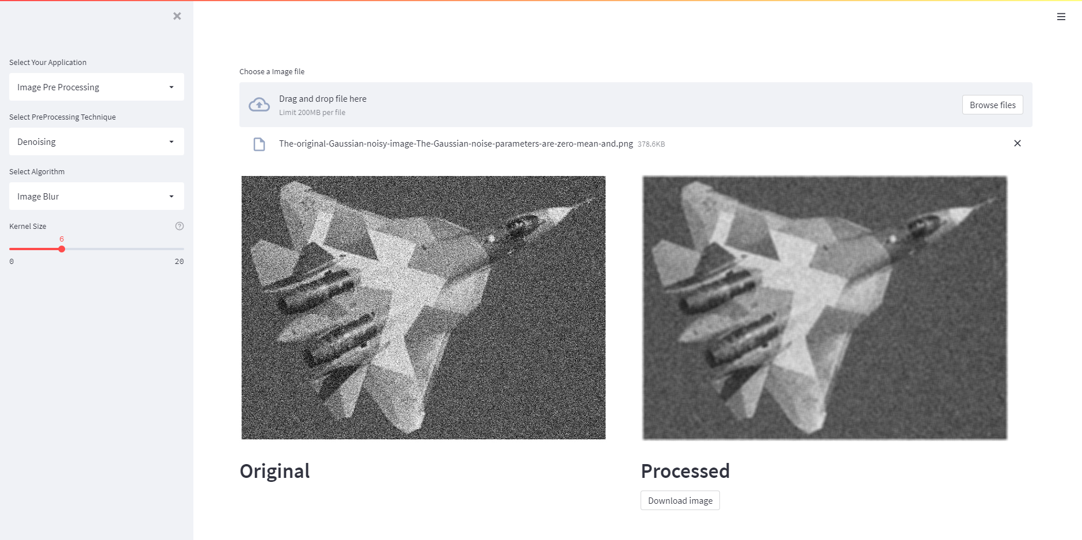
Implementation and results

Slide 11

Implementation and results

Slide 12

Implementation and results

Slide 13
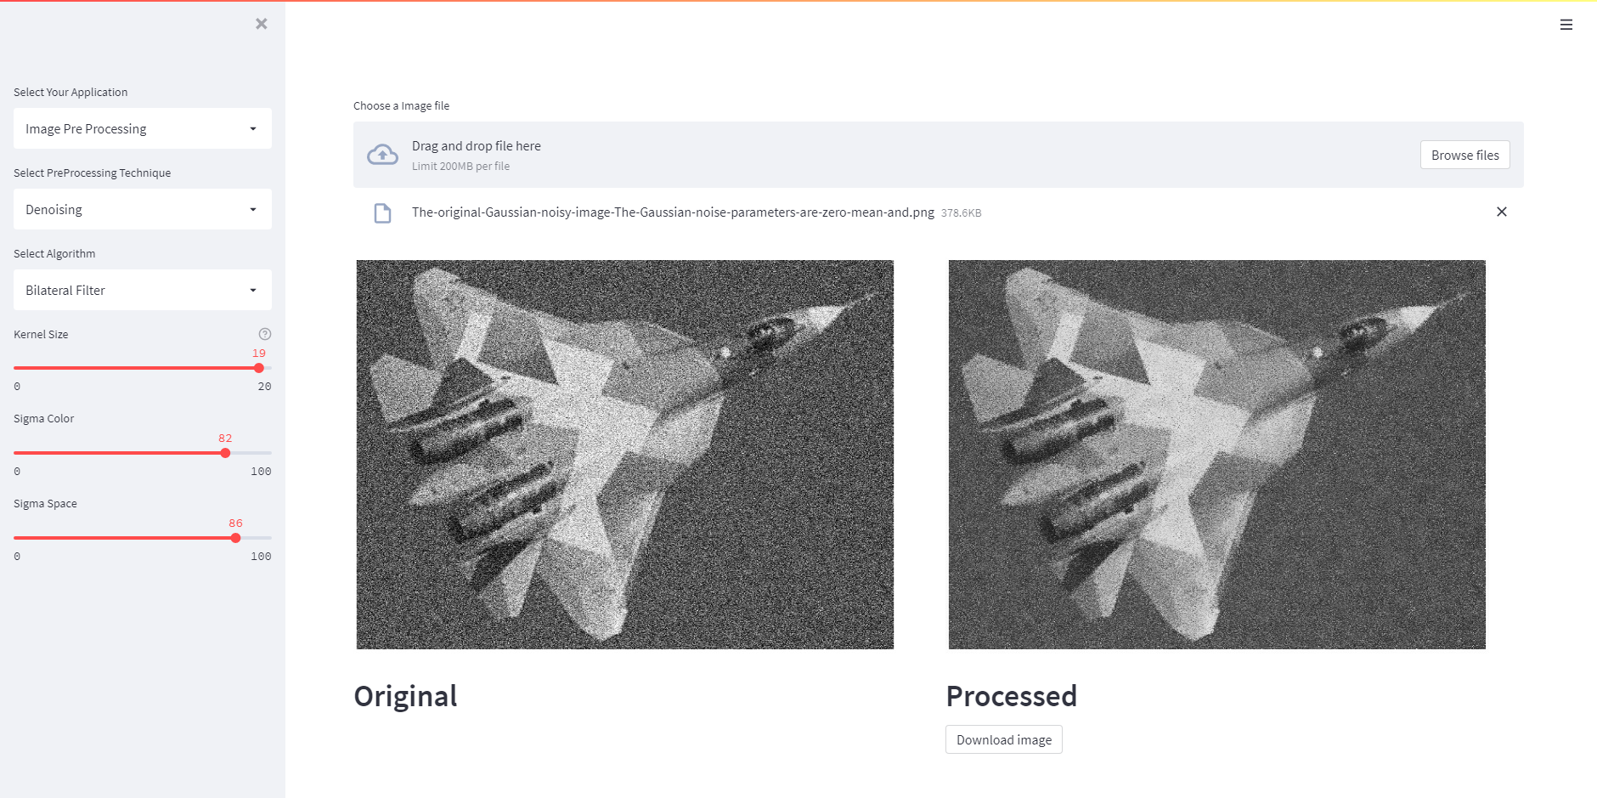
Implementation and results
Notes:
Bilateral preserve edges whereas the rest smudge it

Slide 14

Implementation and results

Slide 15
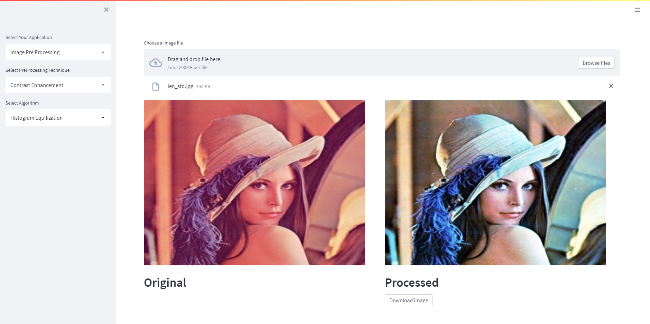
Implementation and results

Slide 16
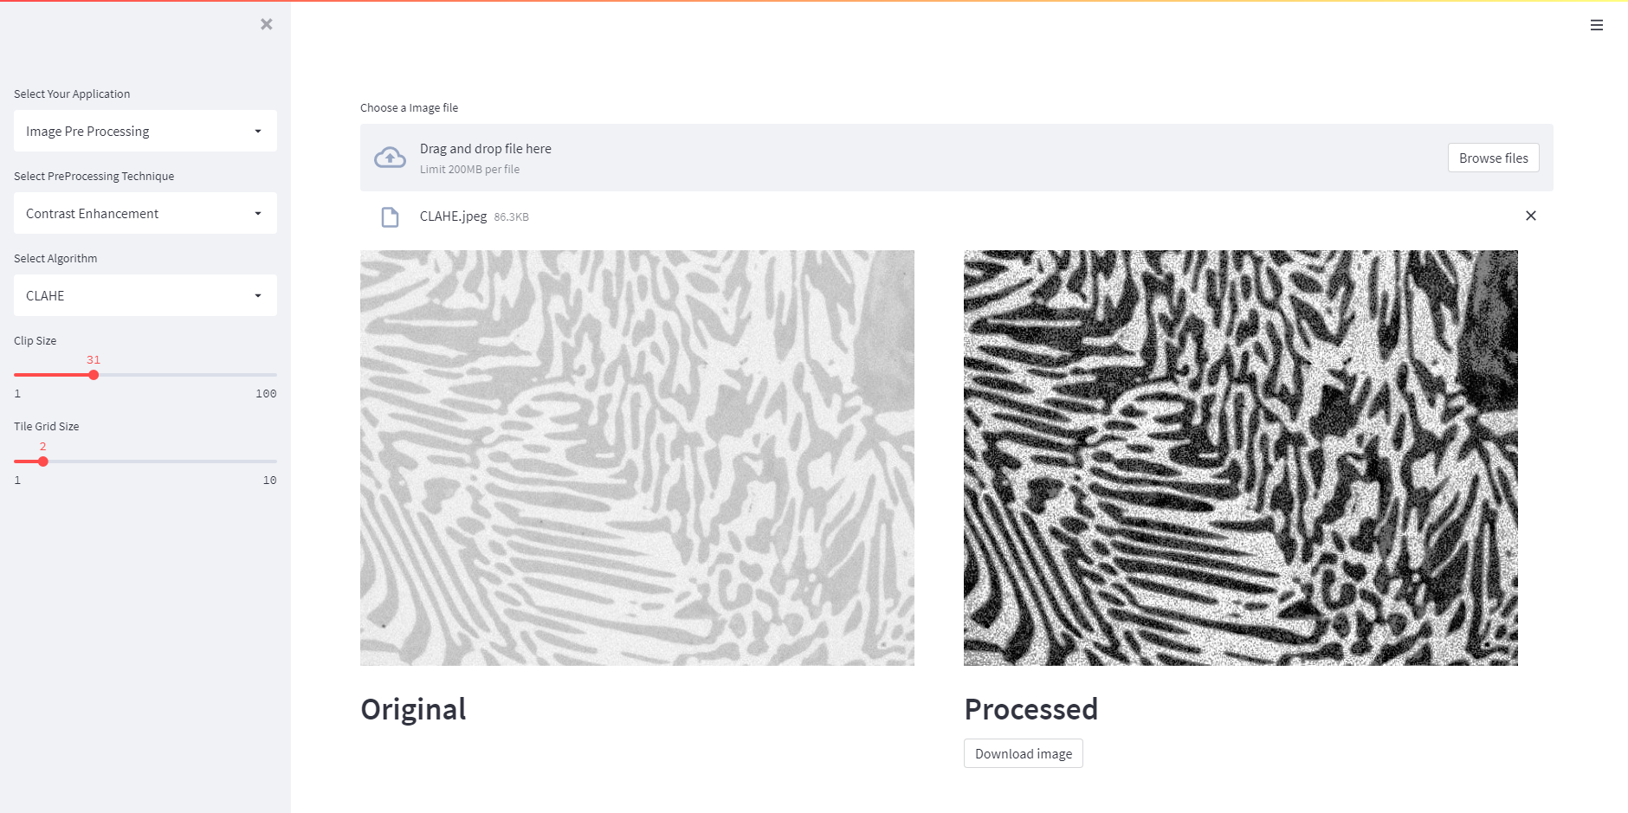
Implementation and results

Slide 17
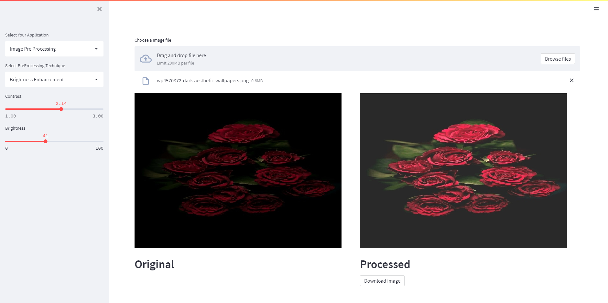
Implementation and results

Slide 18
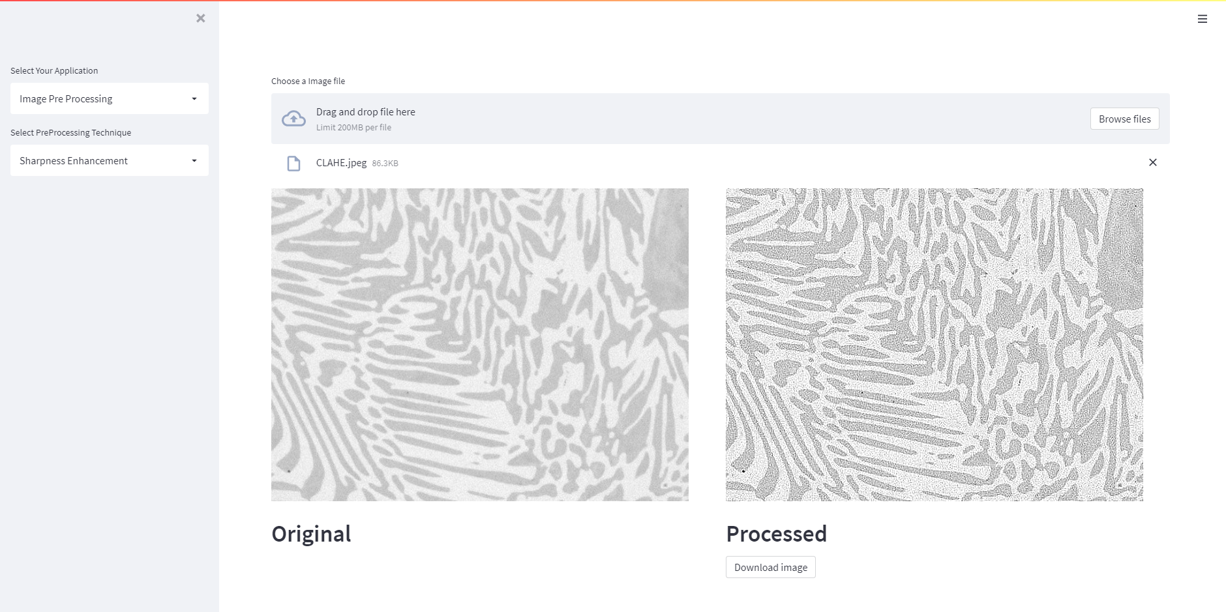
Implementation and results

Slide 19
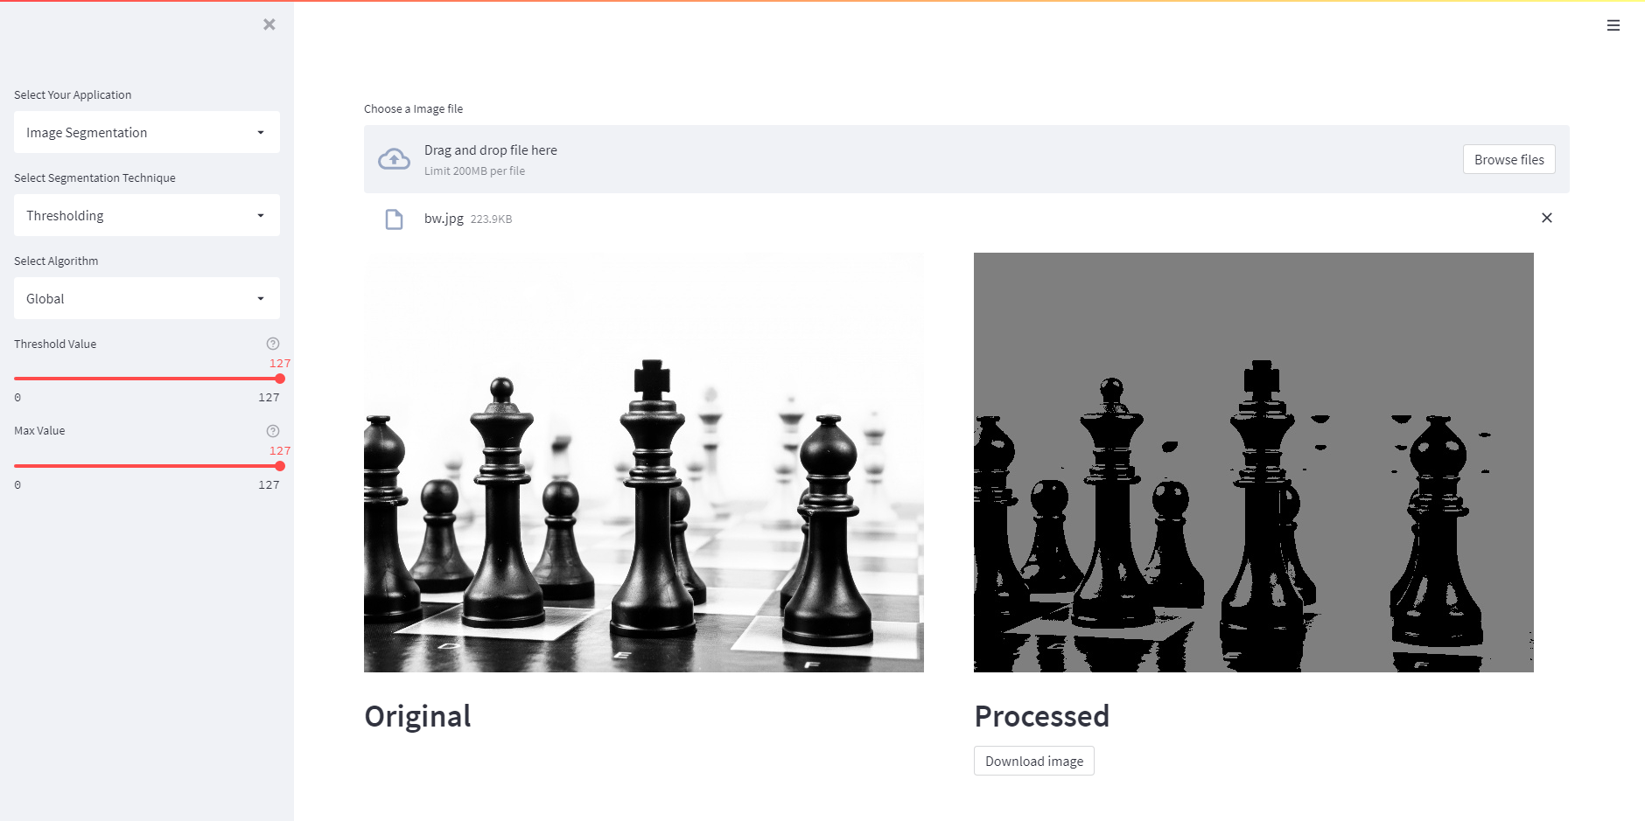
Implementation and results

Slide 20
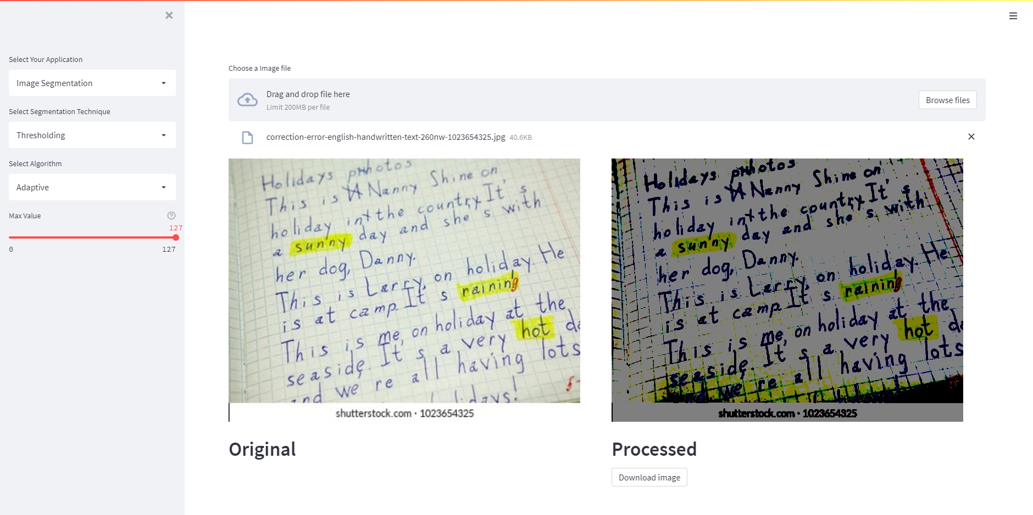
Implementation and results

Slide 21
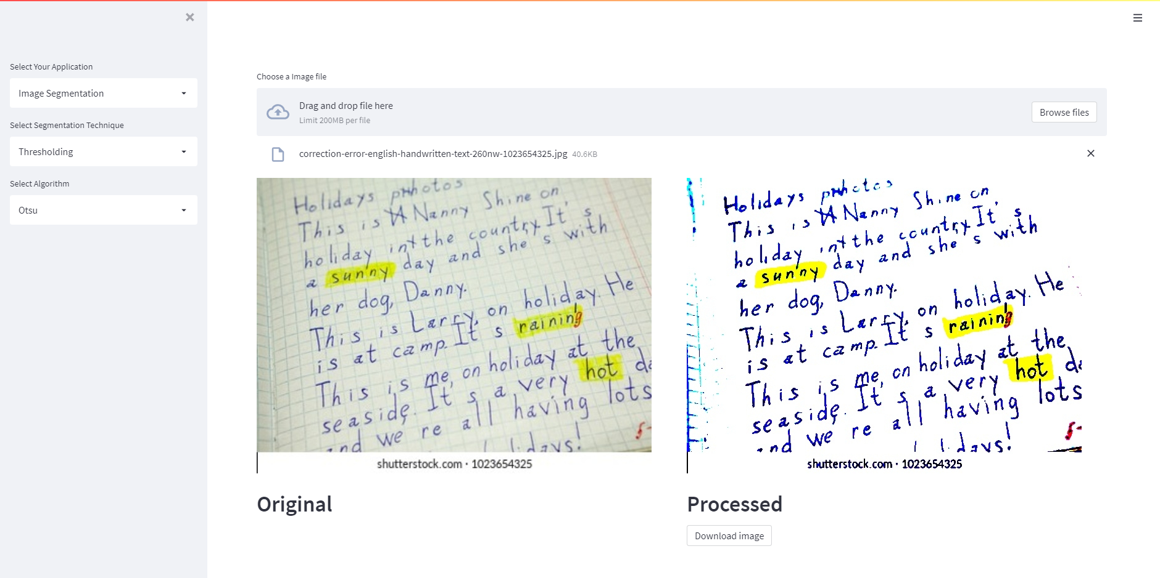
Implementation and results

Slide 22
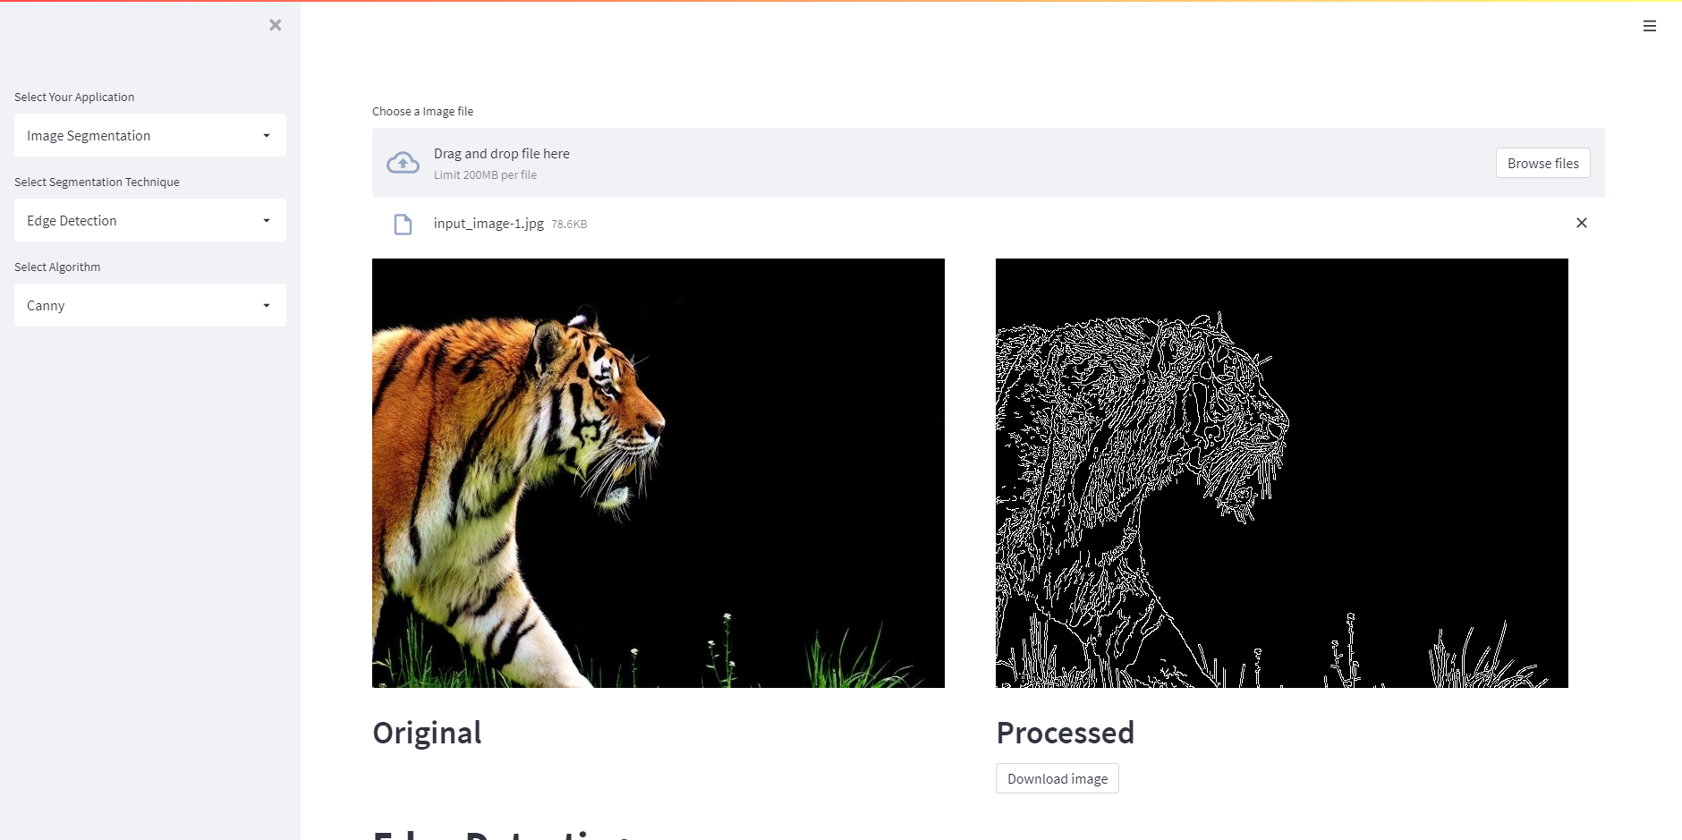
Implementation and results

Slide 23
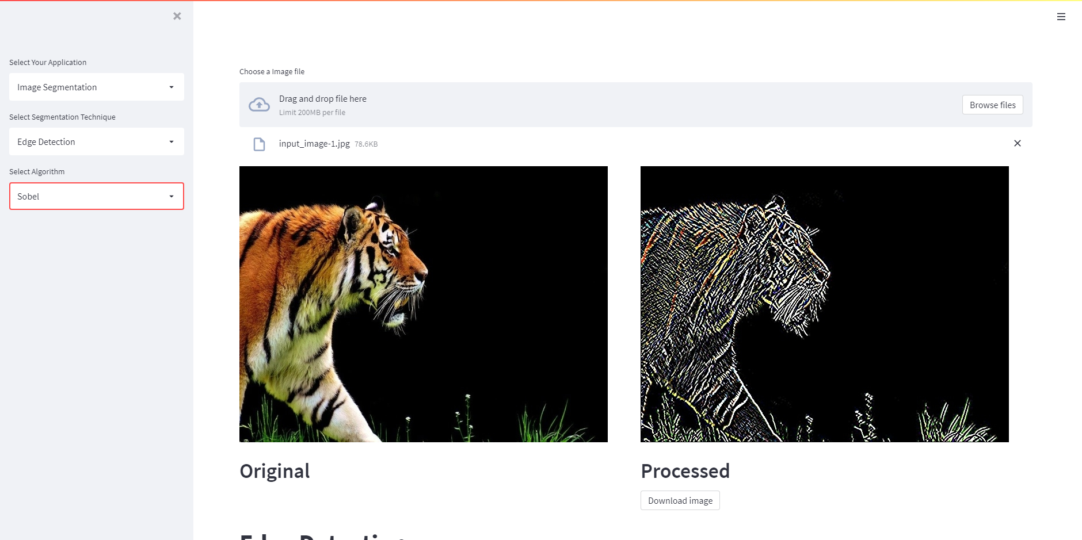
Implementation and results

Slide 24
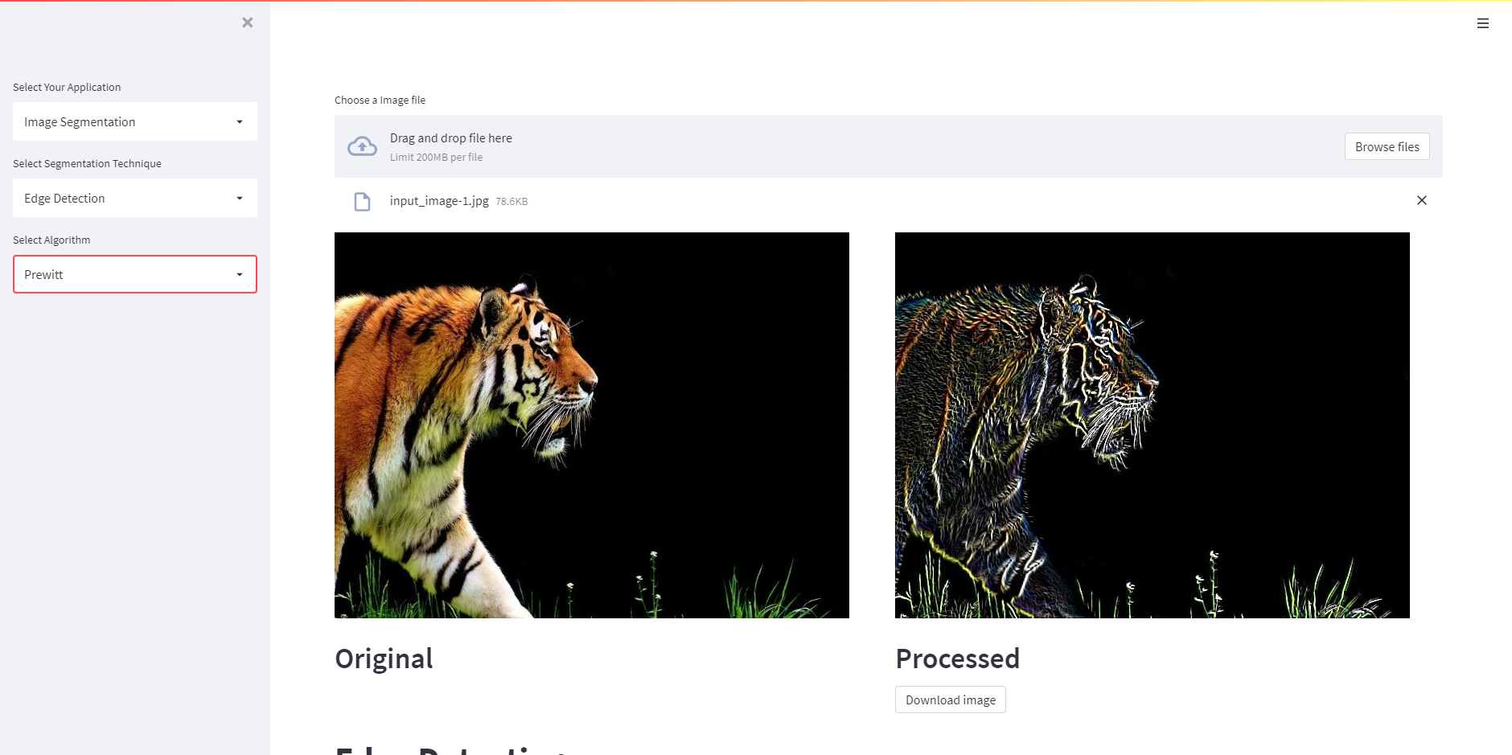
Implementation and results

Slide 25
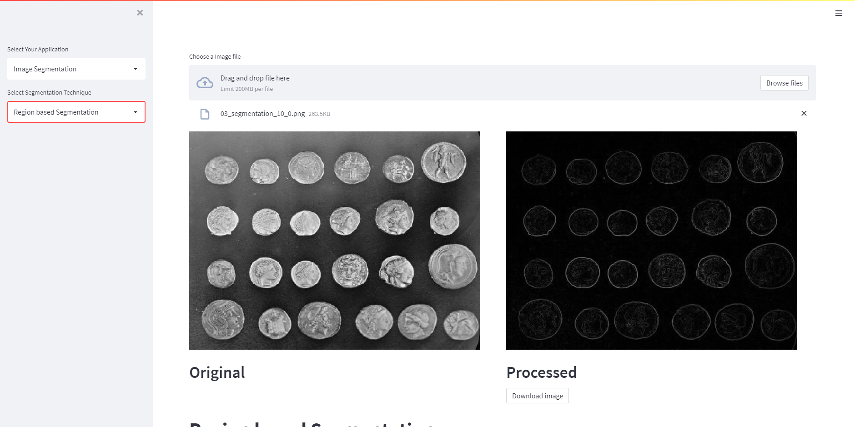
Implementation and results

Slide 26
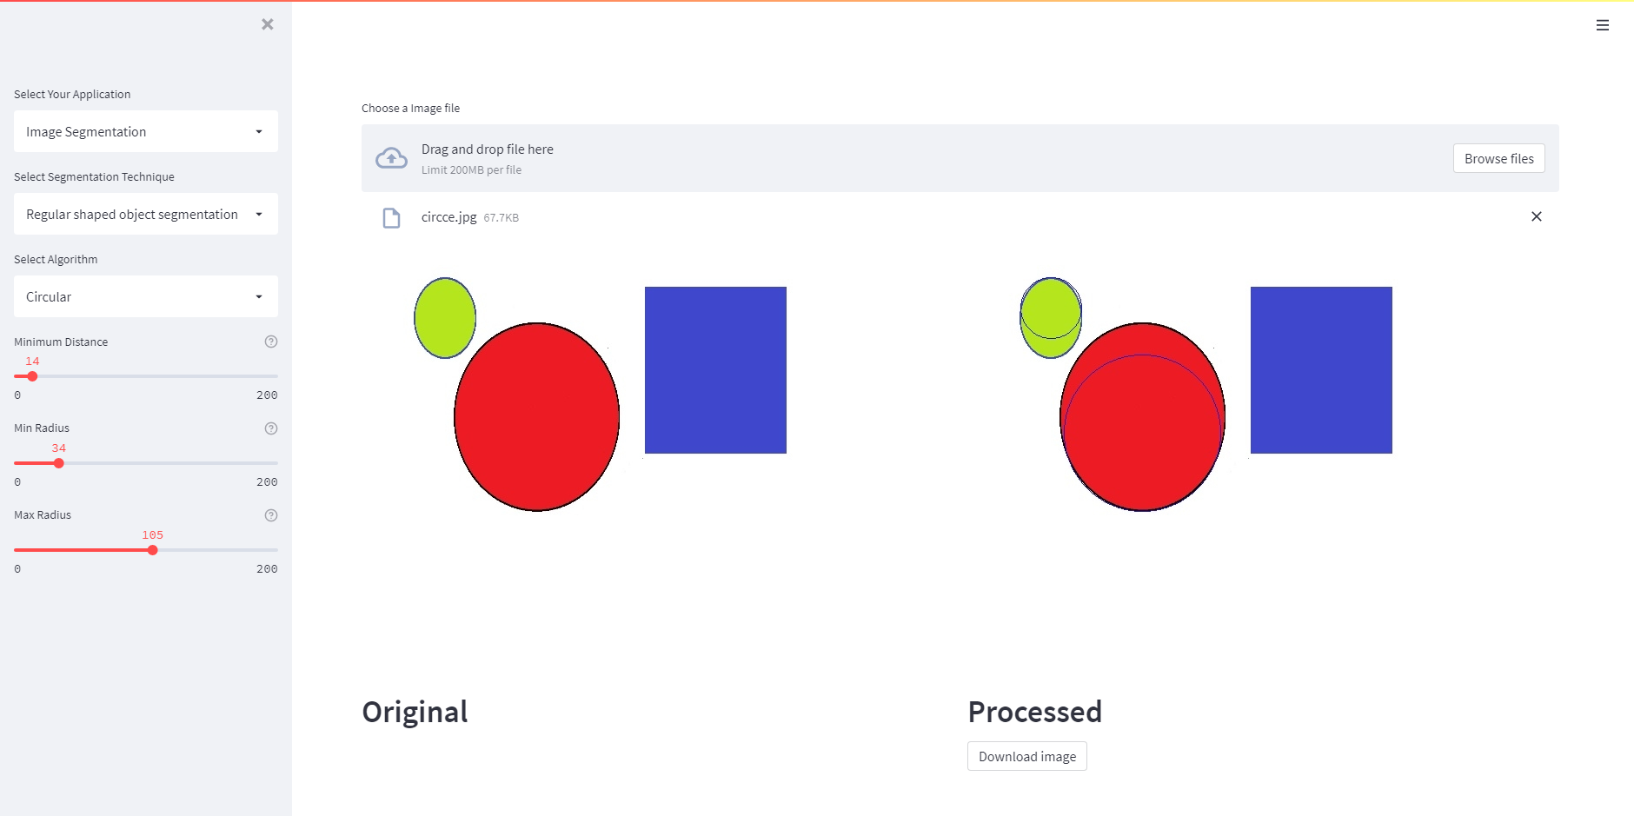
Implementation and results

Slide 27
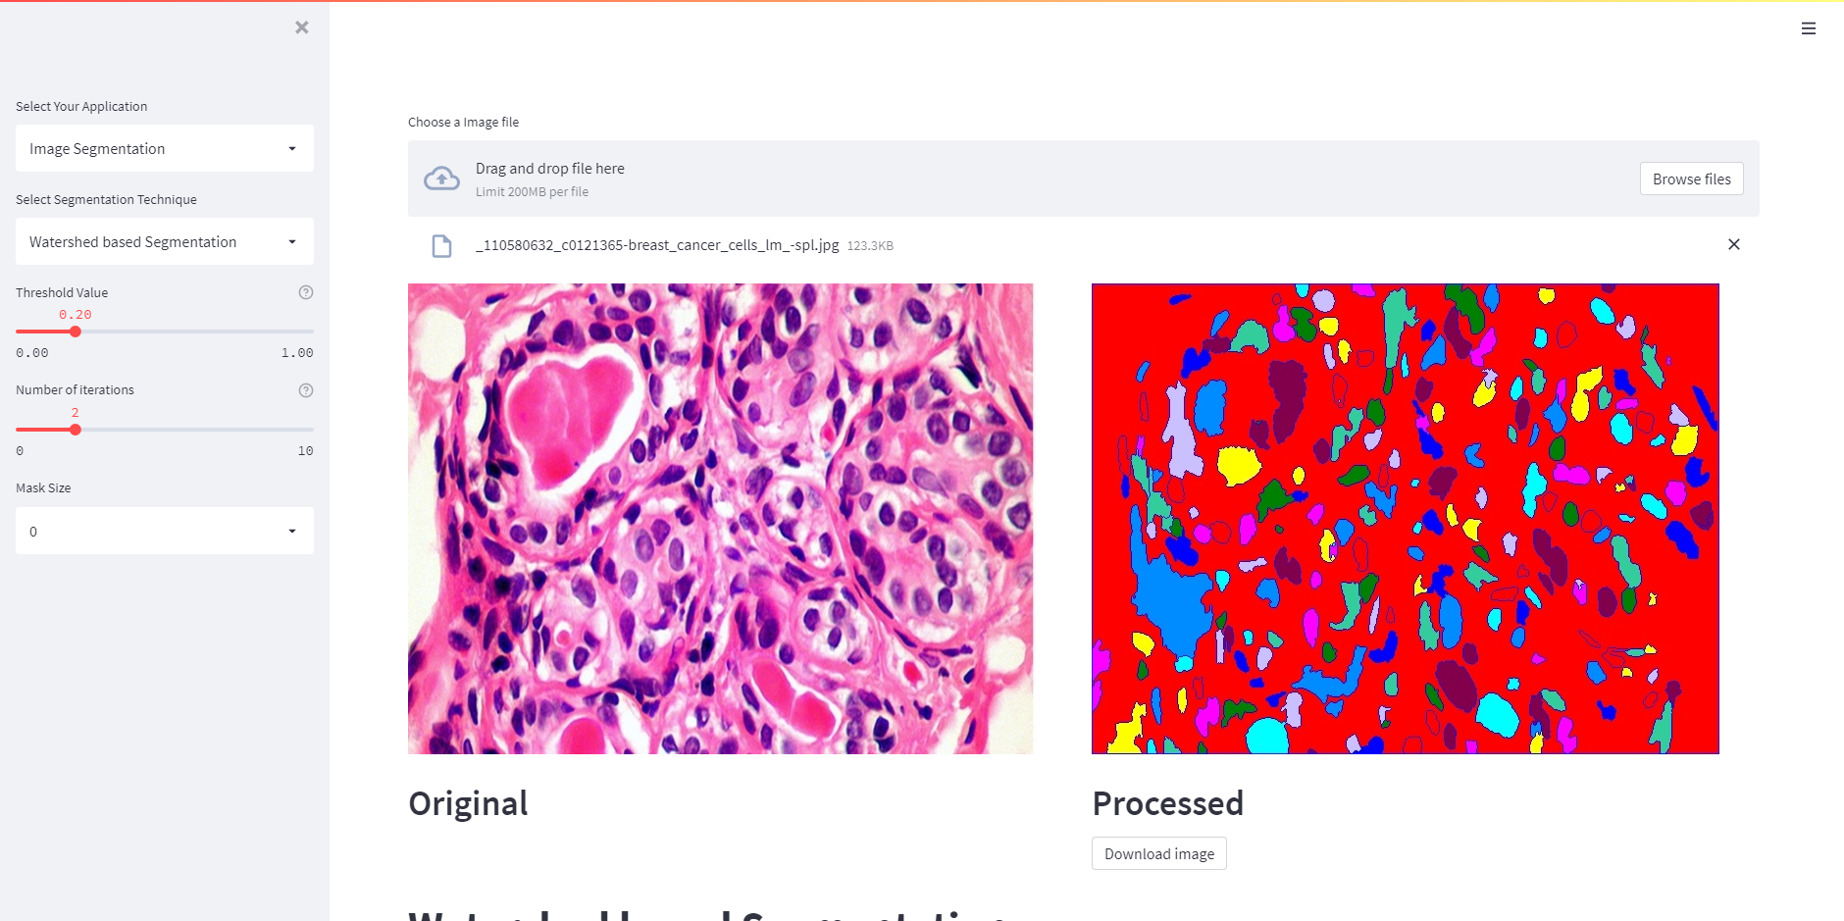
Implementation and results

Slide 28
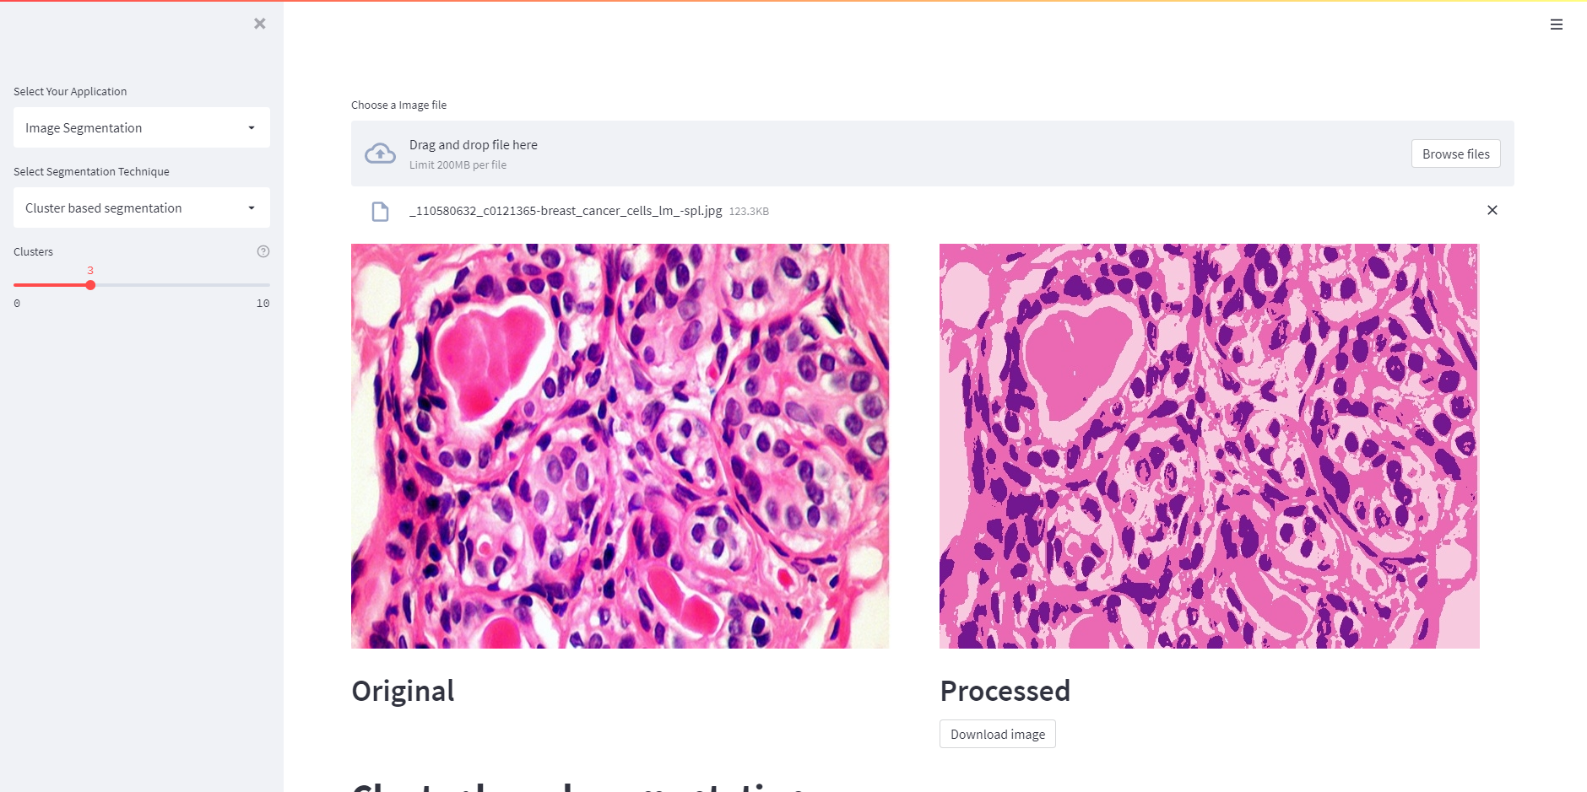
Implementation and results

Slide 29
Conclusion
The project tried to make all the image processing functions available in one place
It aimed to make controlling various parameters easy with a single click
Some algorithms work well and are suitable for only a particullar type of image. The comparison section makes comparing two algorithms easier
With the addition of new functions the project can be made more robust and efficient.

Slide 30


